Slide 1
Getting Started on Building Tables
Using SSMS and SQLCMD

Slide 2
Data Dictionary: (Convert RS to DD Chart/Matrix) Elements you need to know to get started
Table: Field
Column Name | Description | Data Type | Size | Identity | Unique | Default | Check | Allow Nulls | Index
FieldName | PK; Unique field name | varchar | 20 |  |  |  |  |  | Y
Street | Field street | varchar | 30
City | Field city | varchar | 25
State | Field state | char | 2 |  |  | ‘FL’ | LIKE ‘[A-Z][A-Z]’
Zip | Field zip | char | 5 |  |  |  | LIKE '[0-9][0-9] [0-9][0-9][0-9]'
Table: Match
Column Name | Description | Data Type | Size | Identity | Unique | Default | Check | Allow Nulls | Index
MatchID | PK; Unique sequential match ID number | smallint |  | Y |  |  |  |  | Y
Date | Date match scheduled | date |  |  |  |  | >= GETDATE()
FieldName | FK to Field table; location of match | varchar | 20
Table: Match Outcome
Column Name | Description | Data Type | Size | Identity | Unique | Default | Check | Allow Nulls | Index
MatchID | CPK; FK to Match table | smallint |  |  |  |  |  |  | Y
TeamName | CPK; FK to Team table | varchar | 20 |  |  |  |  |  | Y
Score | Goals scored in match by team | tinyint |  |  |  |  | >= 0 | Y

Slide 3
Properties: Definitions and Terms to get you started
Identity (auto generated) – Surrogate PK
Seed and increment
Default value
Auto filled by SQL Server, when you hit tab or when value not in insert statement
Naming (indexes and Constraints)
PK_Index, AK_Index, UN_Index, IX_Index
CK_check
CN_constraint (rule, default, check)
PK-FK Relationship
FK_ForeigntablePrimarytable

Slide 4
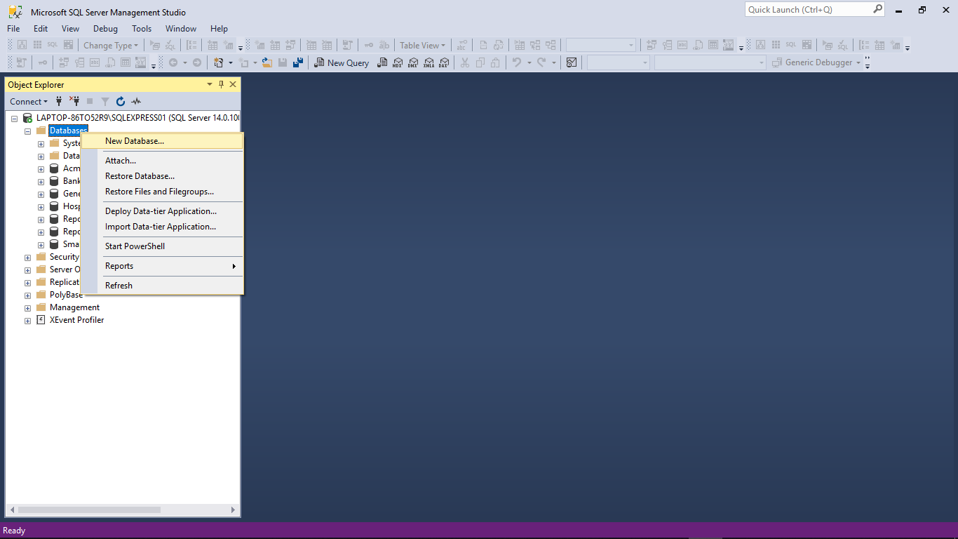
Getting Started with SSMS: Create New Database

Slide 5
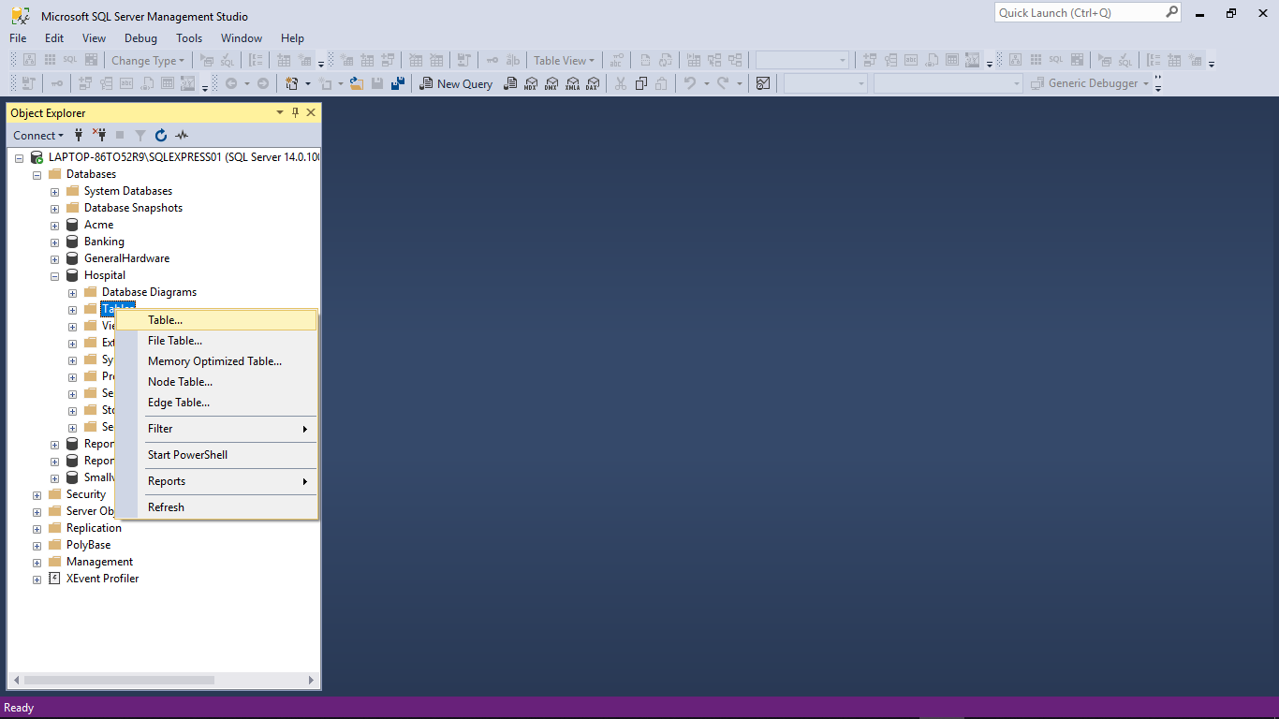
Building Tables with SSMS: Create New Table

Slide 6
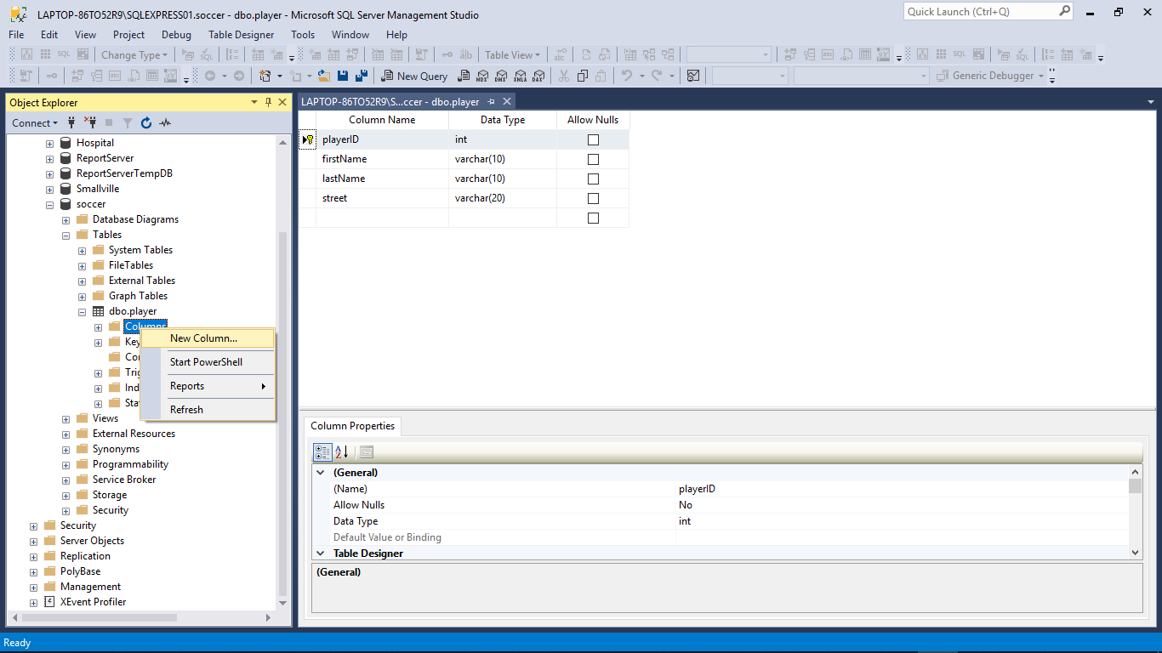
Add columns to your table

Slide 7
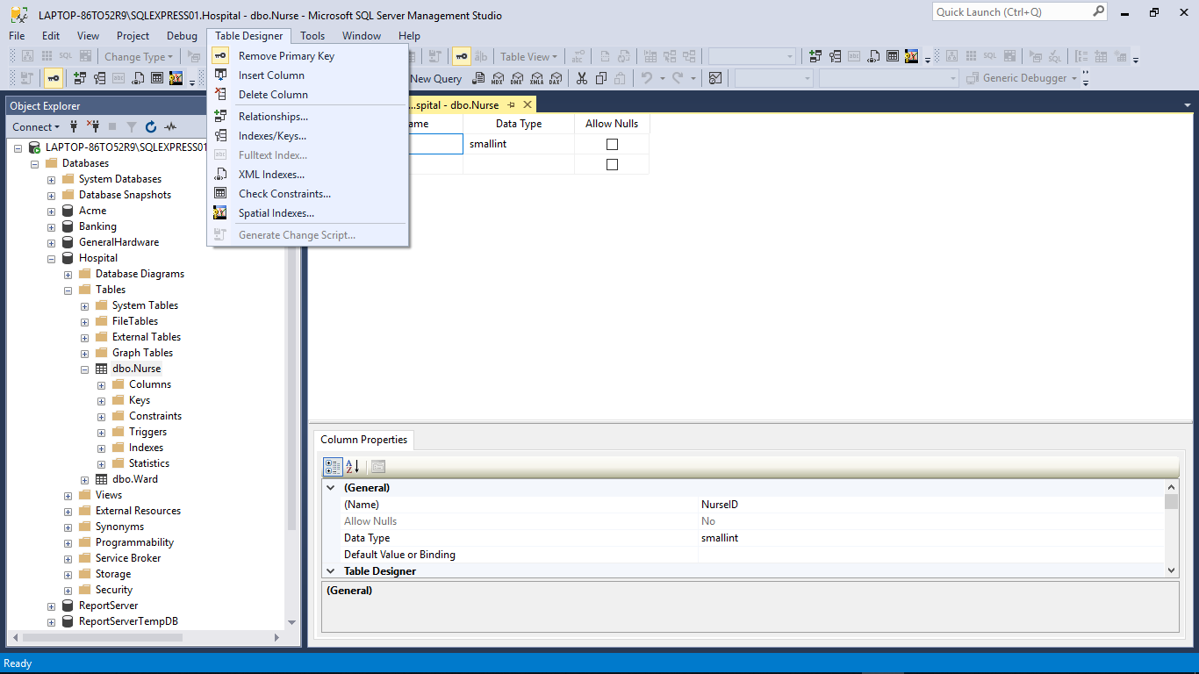
Alter Tables with SSMS: Table Designer, Properties
Column properties versus table properties

Slide 8
Data Dictionary: Why you need these items
Table: Field
Column Name | Description | Data Type | Size | Identity | Unique | Default | Check | Allow Nulls | Index
FieldName | PK; Unique field name | varchar | 20 |  |  |  |  |  | Y
Street | Field street | varchar | 30
City | Field city | varchar | 25
State | Field state | char | 2 |  |  | ‘FL’ | LIKE ‘[A-Z][A-Z]’
Zip | Field zip | char | 5 |  |  |  | LIKE '[0-9][0-9] [0-9][0-9][0-9]'
Table: Match
Column Name | Description | Data Type | Size | Identity | Unique | Default | Check | Allow Nulls | Index
MatchID | PK; Unique sequential match ID number | smallint |  | Y |  |  |  |  | Y
Date | Date match scheduled | date |  |  |  |  | >= GETDATE()
FieldName | FK to Field table; location of match | varchar | 20
Table: Match Outcome
Column Name | Description | Data Type | Size | Identity | Unique | Default | Check | Allow Nulls | Index
MatchID | CPK; FK to Match table | smallint |  |  |  |  |  |  | Y
TeamName | CPK; FK to Team table | varchar | 20 |  |  |  |  |  | Y
Score | Goals scored in match by team | tinyint |  |  |  |  | >= 0 | Y

Slide 9
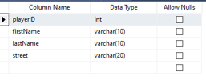
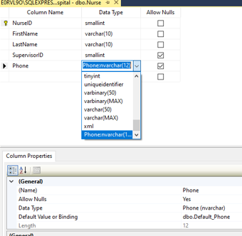
Let’s take a closer look at data types
A lot of interesting things going on here

Slide 10
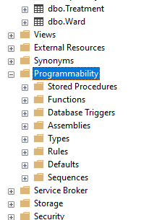
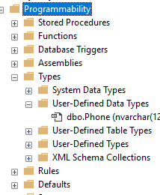
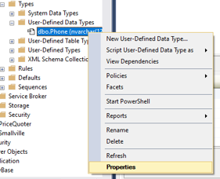
User-Defined Data Types

Slide 11
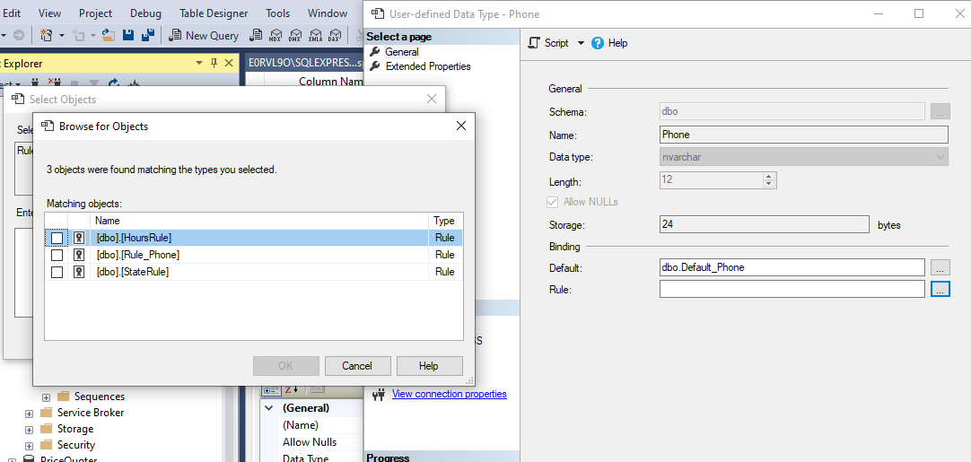
Set the properties and constraints (rules, defaults)

Slide 12
Now you have a customized data type to constrain your column

Slide 13
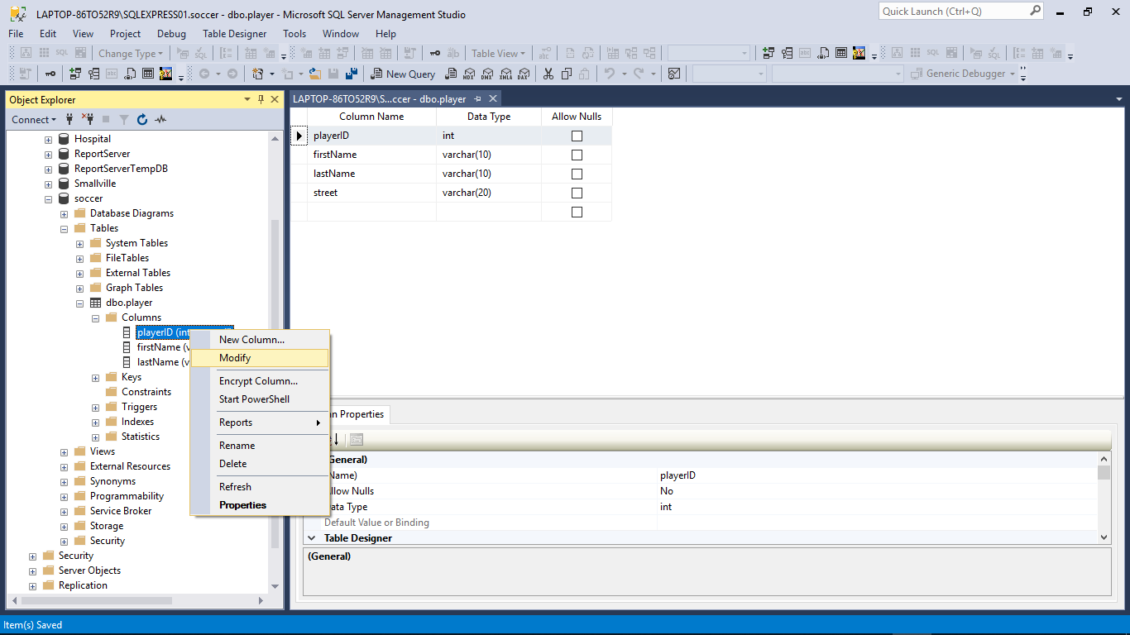
Now let’s Alter some more constraints on our Table

Slide 14
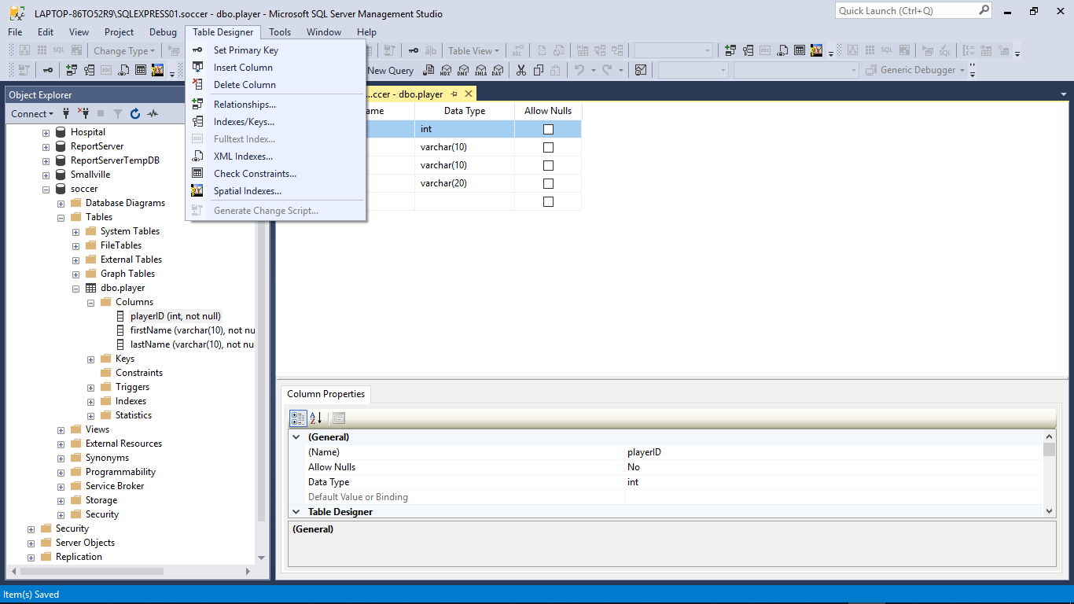

Slide 15
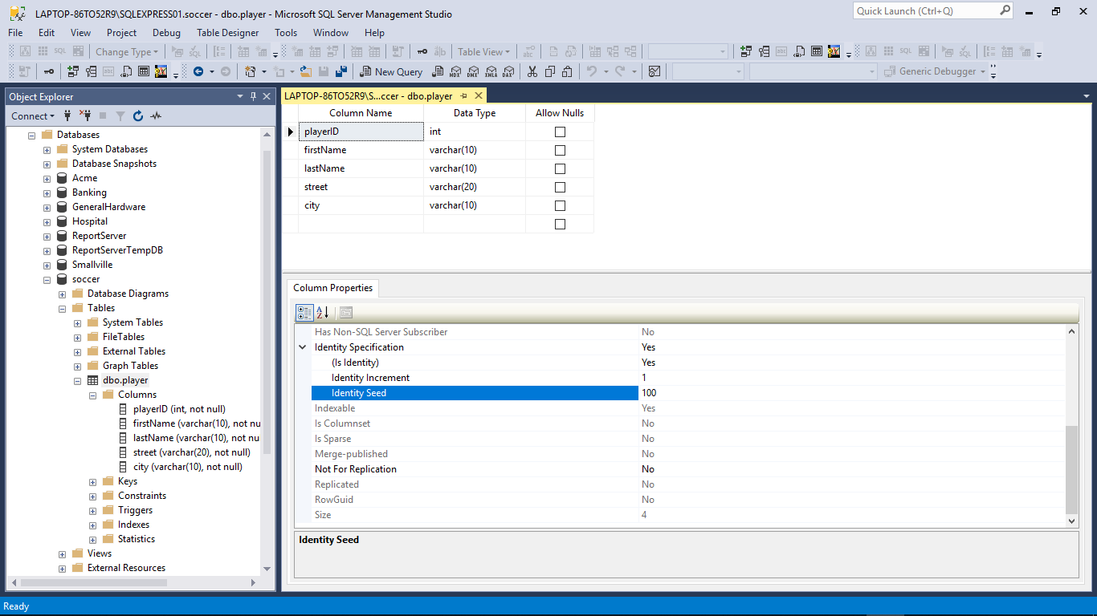

Slide 16
We have now: - created a table - added columns - set constraints - altered the table Next, let’s: - add records - run queries

Slide 17
Entering Data and Running Queries
Entering Data/records
SSMS (edit rows)
SQLCMD (Insert statement)
Queries
New Query (SSMS)
Select statement (select, from, where)
SQLCMD

Slide 18
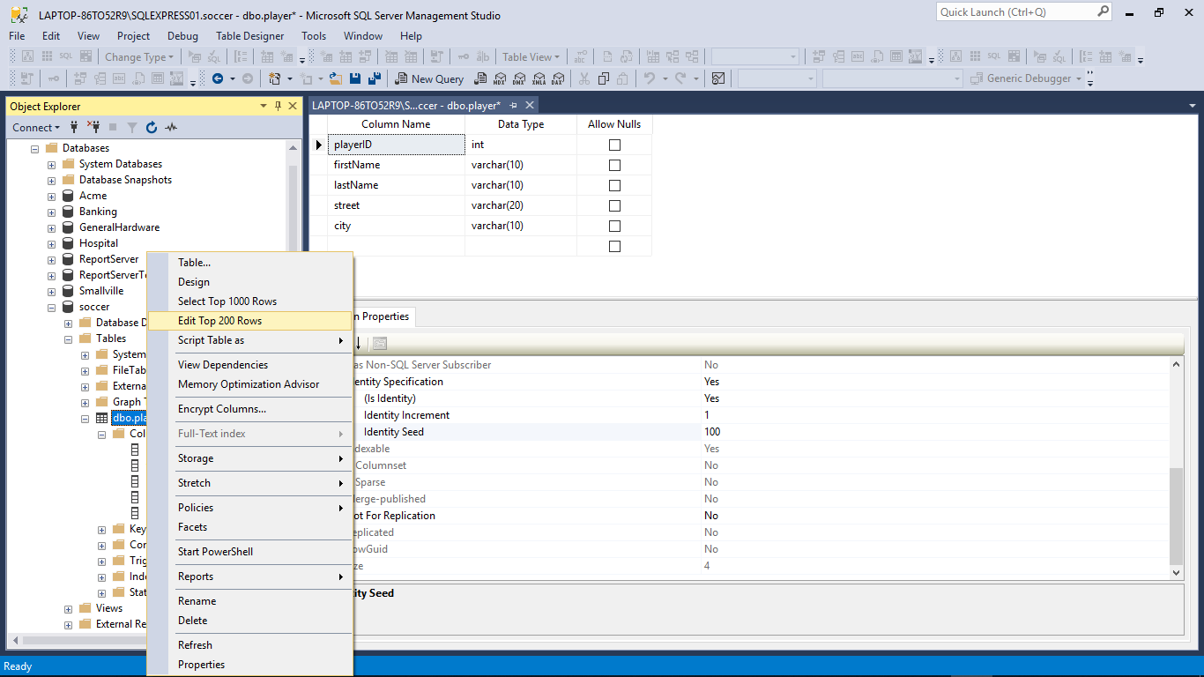
Manual insert of record using SSMS

Slide 19
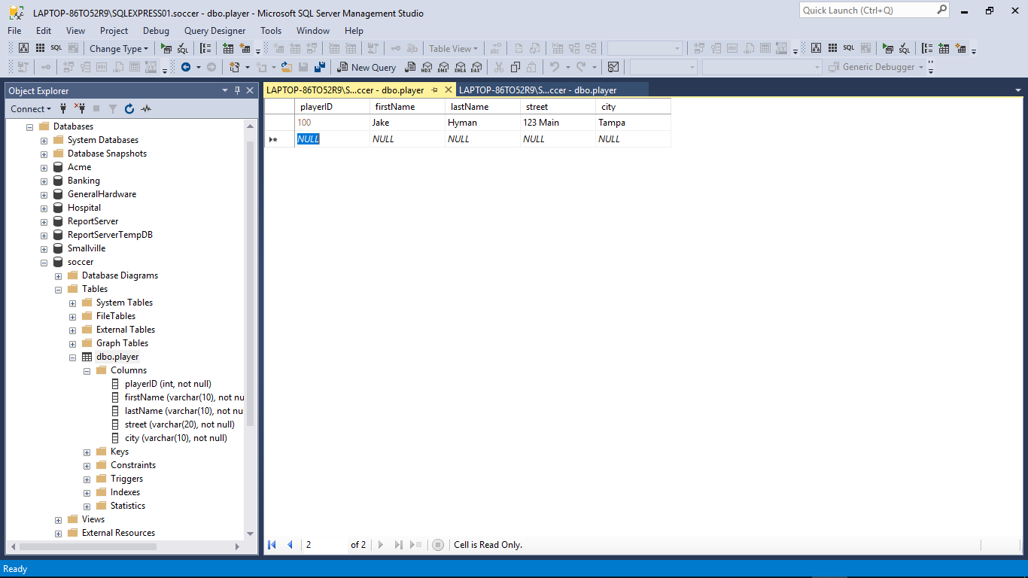

Slide 20
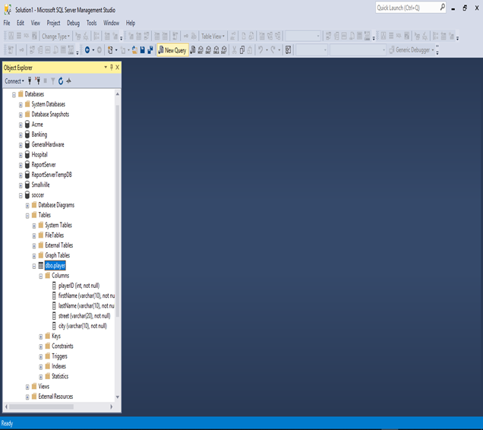
Let us run a query now

Slide 21
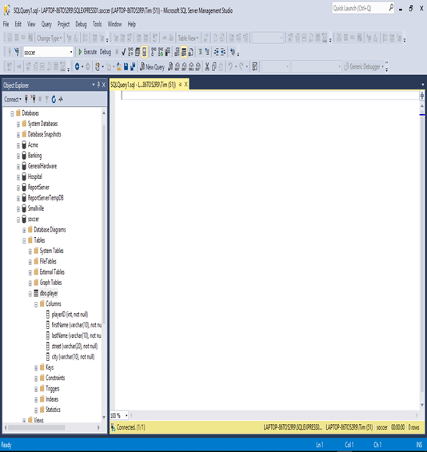

Slide 22
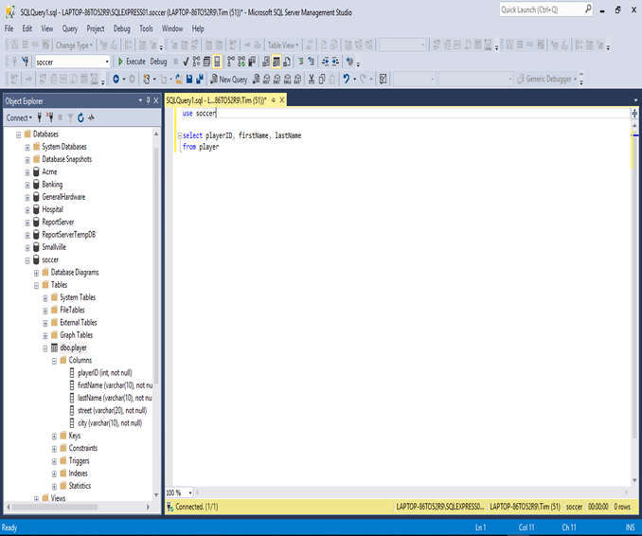
use soccer
select playerID, firstName, lastName
from player

Slide 23
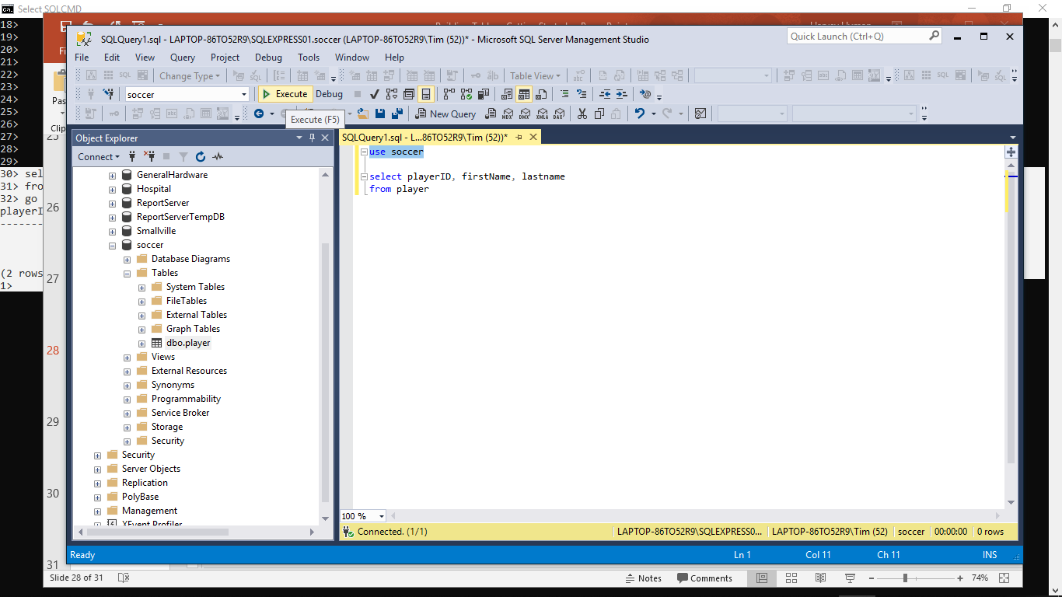

Slide 24
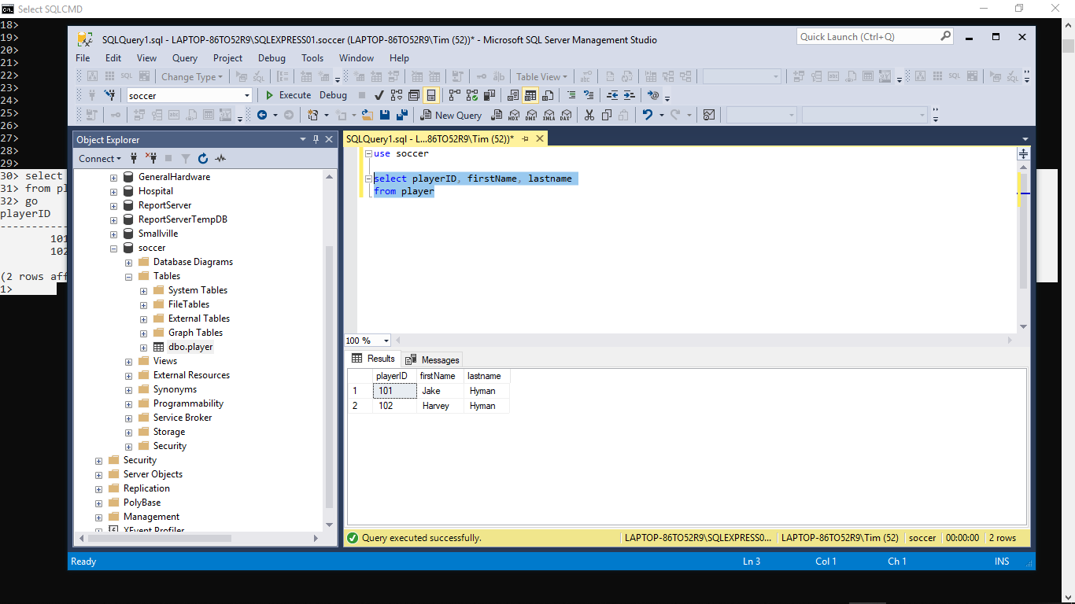

Slide 25
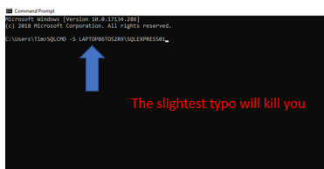
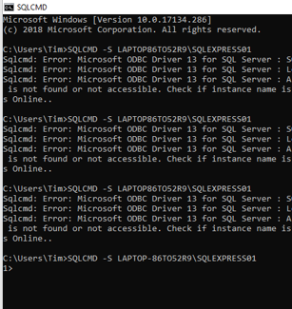
Getting Started with SQLCMD
Good to go

Slide 26
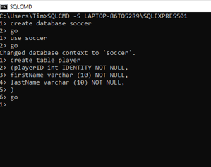
Let’s create a Database named ‘Soccer’ and create a Table named ‘Player’ with some columns, in the database…

Slide 27
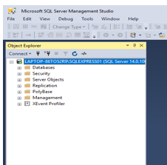
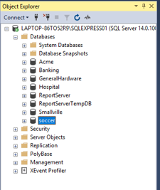

Let’s see if its there…

Slide 28
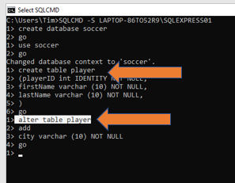

Let’s add a ‘City’ column to the ‘Player’ table

Slide 29
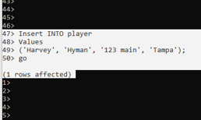
Let’s add a record to the ‘Player’ table
DML
Insert
INTO
Values
(‘literals’);
Identity so I do not include it in INSERT statement
Notice additional column
4 values and 4 columns

Slide 30
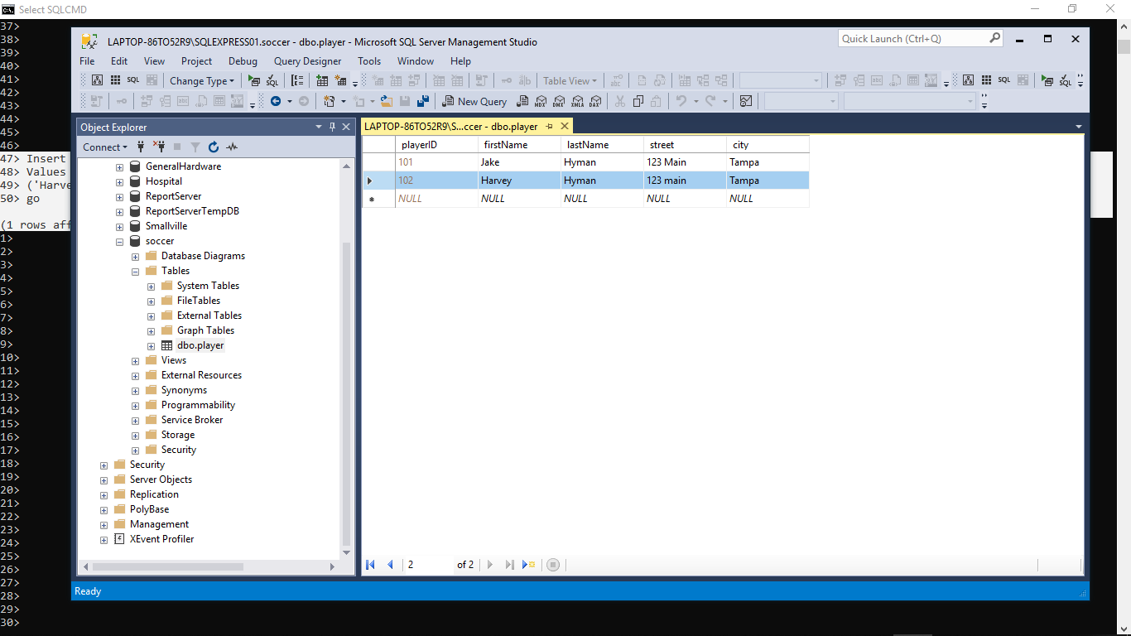
And you know who Bob is

Slide 31
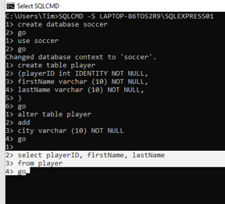
Let’s ask a question (query): Show me all player ID numbers, first names, and last names
DML
Select col1, col2
From table
Where condition
Order by sort

Slide 32
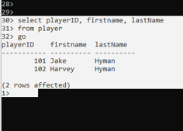

Slide 33
You have everything you need to get started now: - Practice Building Tables with: Hospital or ACME If you are really advanced then try putting it all together with: Dog Salon, Clothing Store

